Slide 1
UVic Course Registration System
Low-fidelity prototype
Zhanchi Guan, Aaron Yin,
Rui Sun, Junhong Deng

Slide 2
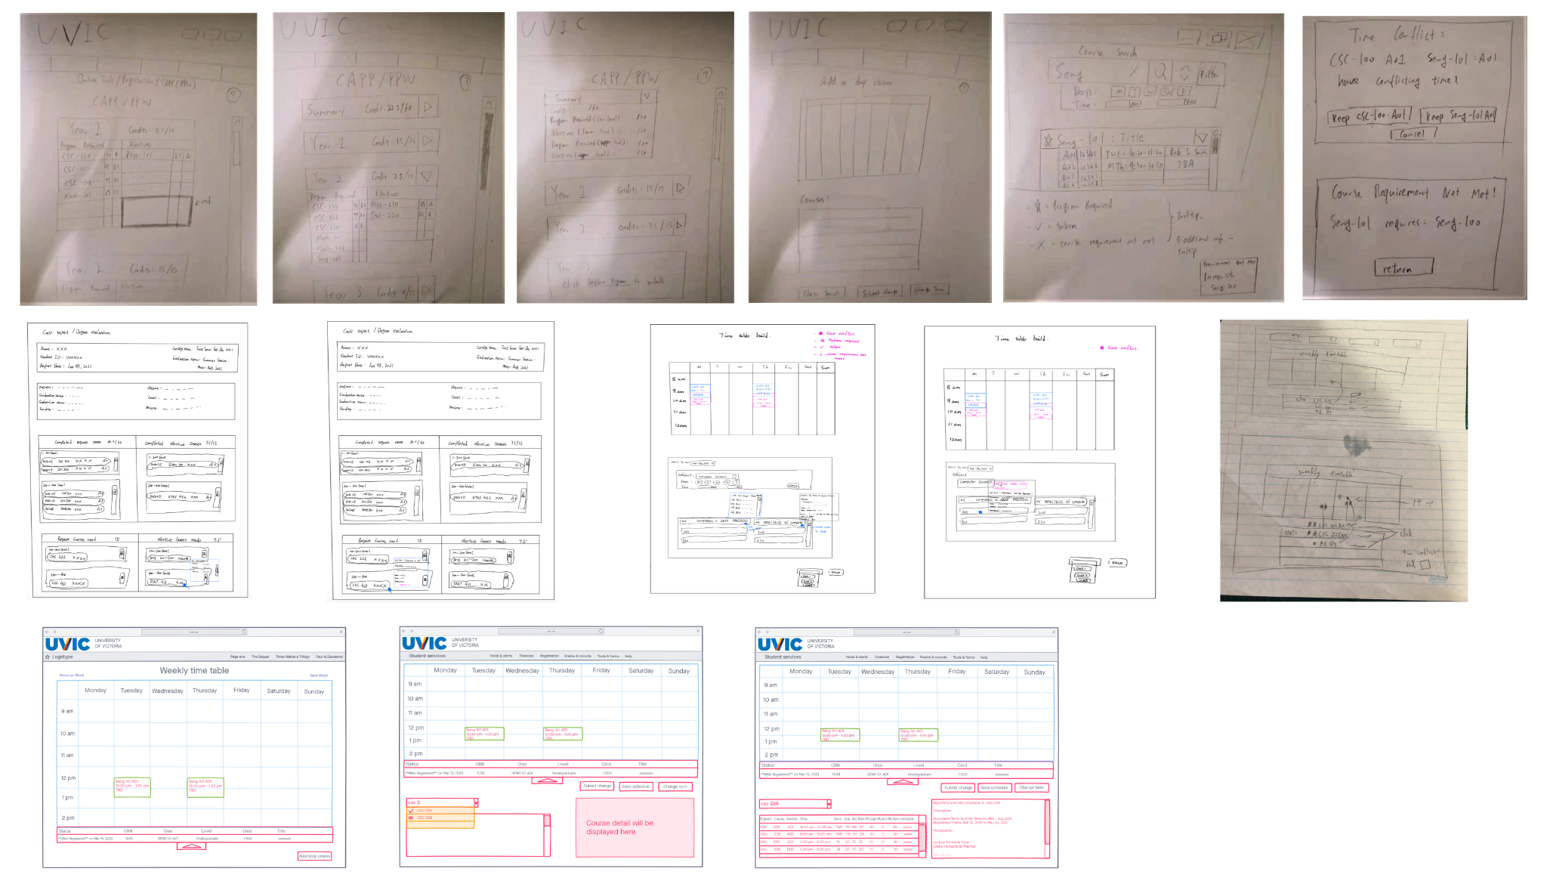
Brainstorm Session

Slide 3
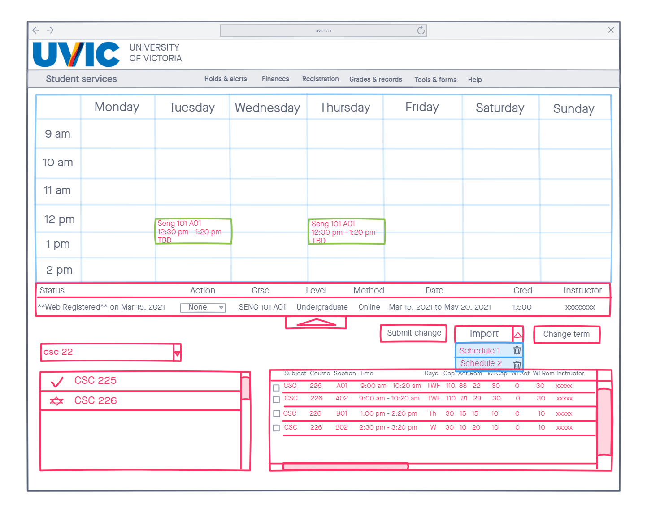
Add or drop courses

Slide 4
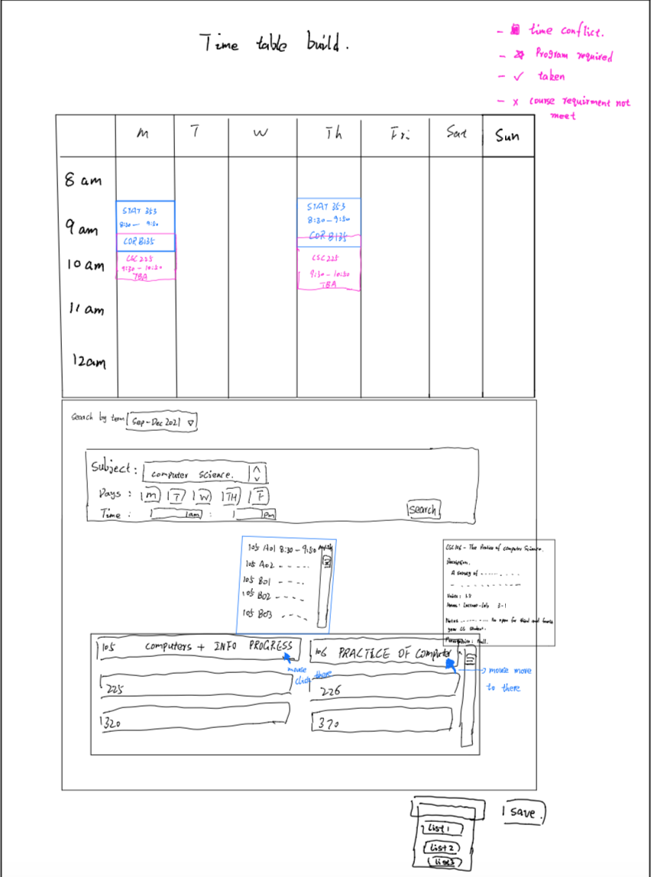
Timetable builder

Slide 5
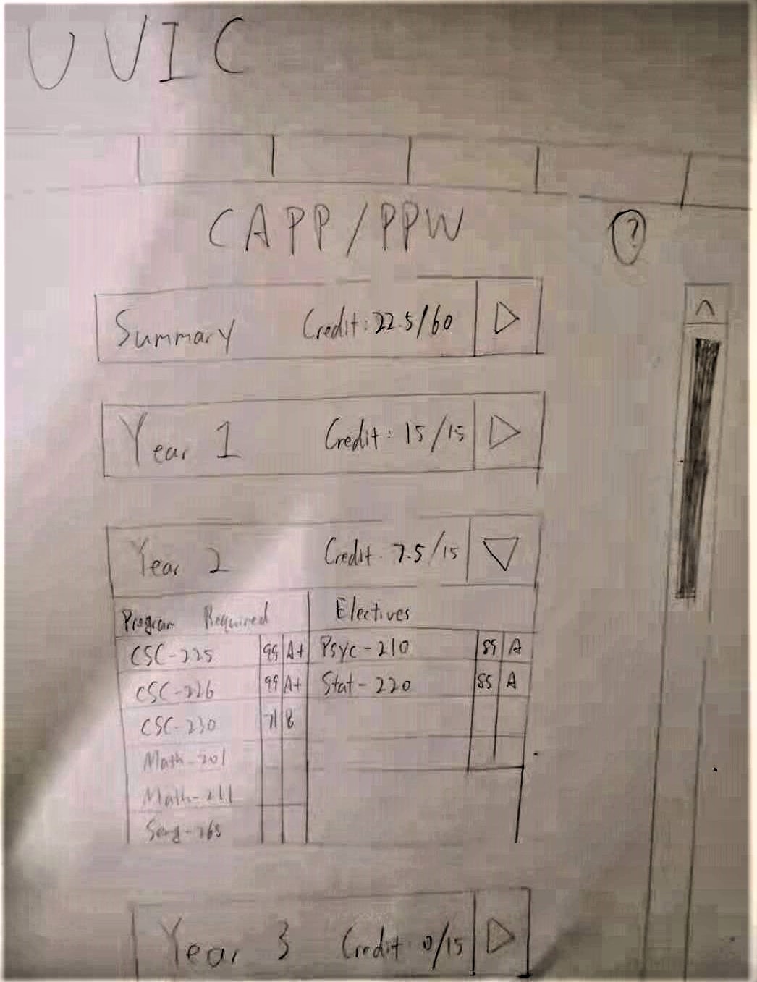
CAPP

Slide 6
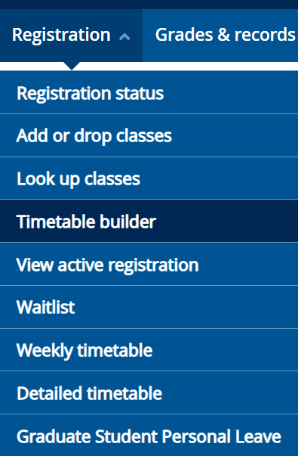
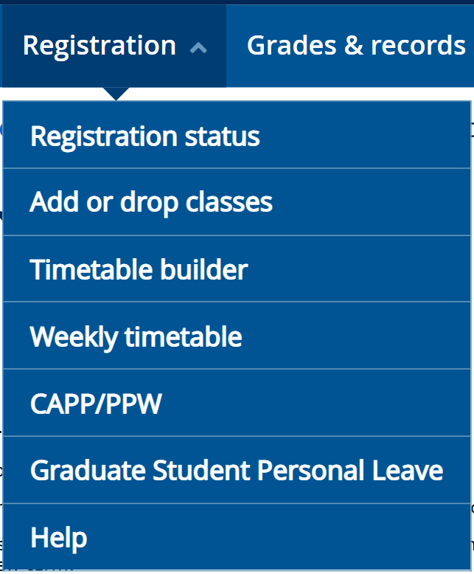
Result

Slide 7
Q & A

Slide 8
Thank you

